Slide 1

Smart Home Automation with Arduino IoT Cloud
Welcome to this presentation on building a smart home automation system using the Arduino IoT Cloud! In this session, we'll explore how to remotely control home appliances from anywhere in the world. We'll discuss the benefits of using the Arduino IoT Cloud, which offers a free, real-time, and scalable platform for your IoT projects. Our main objective is to construct a Wi-Fi-enabled system using NodeMCU and a relay module. Let's dive in and discover the possibilities!
By Batch 11
Saravanan C - 727723eucs214
Santhosh S – 727723eucs208
Saranish R – 727723eucs212
Rudhresh A – 727723eucs196

Slide 2
Introduction to Cloud-Based Home Automation
What?
Why Arduino IoT Cloud?
Objective
Cloud-based home automation allows you to remotely control your home appliances from anywhere using an internet connection. This is achieved through a combination of hardware and software components that communicate with each other via the cloud.
It is free to use for basic projects.
Our goal is to build a simple yet effective Wi-Fi-enabled system using a NodeMCU ESP8266 microcontroller and a 5V relay module, all managed through the Arduino IoT Cloud.
Offers real-time control over your devices.
It is highly scalable for larger deployments.

Slide 3
Essential Components for Your Smart Home Project
1
NodeMCU ESP8266
2
5V Relay Module
3
Jumper Wires + Breadboard
The brain of the operation, providing Wi-Fi connectivity.
Acts as a switch to control the AC appliance.
Facilitate easy connections and prototyping.
4
AC Bulb
5
Arduino IoT Cloud
Serves as the demo load, representing a home appliance.
The platform for remote control and monitoring.

Slide 4
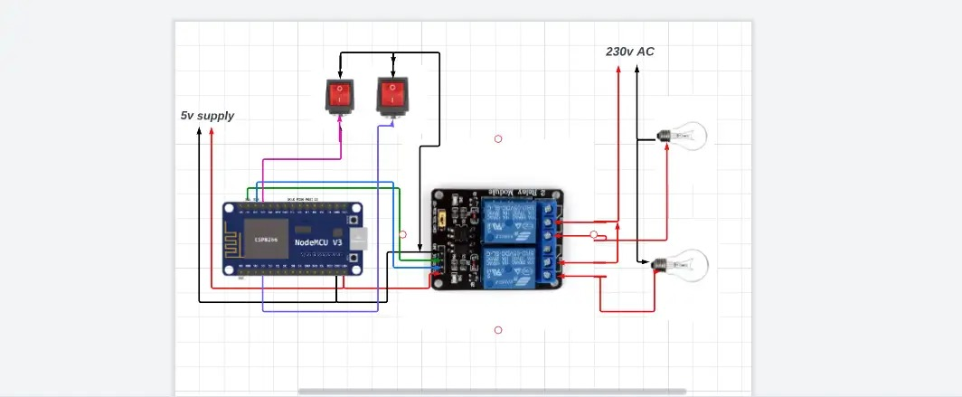
Understanding the Circuit Diagram
Key Connections
Isolation
Important Safety Note
The NodeMCU's digital pins (D1/D2) connect to the relay module, which in turn controls the AC bulb. Ensure proper connections for optimal performance.
It’s crucial to isolate the AC and DC sides of the circuit for safety. This prevents any potential hazards and ensures the longevity of your components.
Warning: Exercise caution when working with AC power. Ensure all connections are secure and insulated to prevent electrical shock.

Slide 5
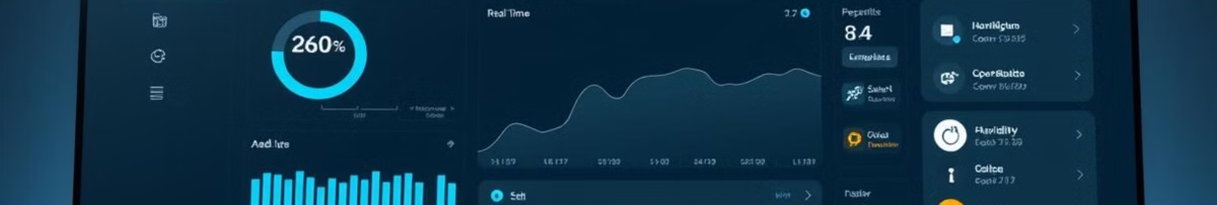



Setting Up Arduino IoT Cloud for Your Project
Create a "Thing"
In the Arduino IoT Cloud, create a new "Thing" to represent your smart home device. This will serve as the digital twin of your physical device.
Add Variables
Define variables such as light1 and light2 to control the state of your appliances. These variables will be linked to your NodeMCU's code.
Upload Code
Upload the auto-generated code to your NodeMCU. This code will handle the communication between your device and the Arduino IoT Cloud.

Slide 6
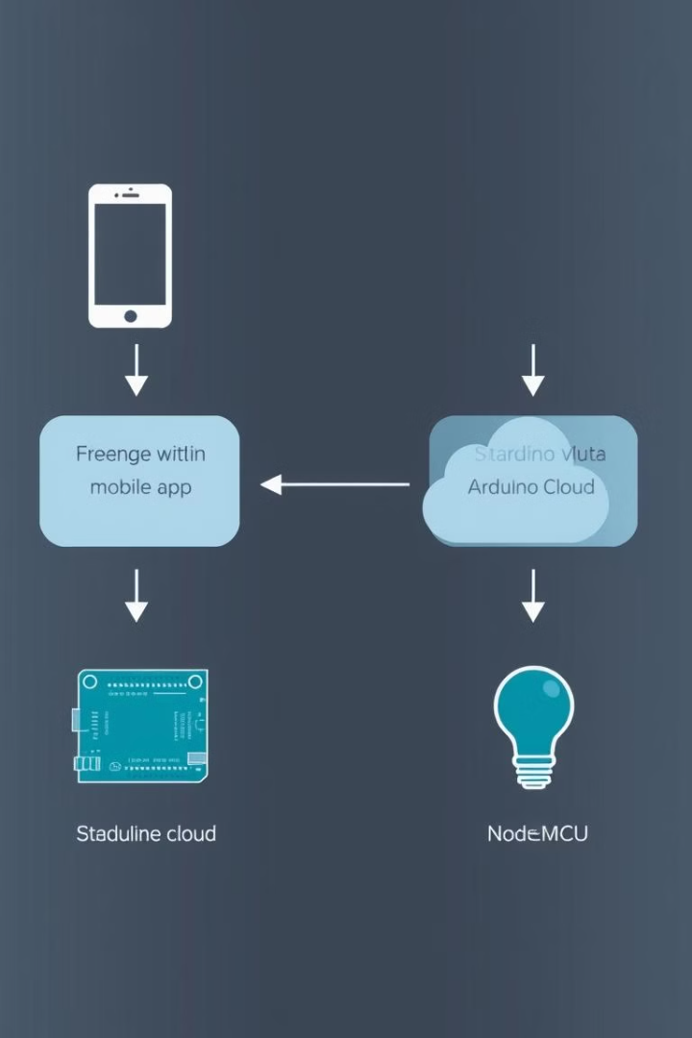
How It Works: The Flow of Control
1
User
The user interacts with the Arduino IoT Cloud dashboard to control the appliance.
2
Arduino Cloud
The Arduino IoT Cloud receives the user's command and forwards it to the NodeMCU.
3
NodeMCU
The NodeMCU interprets the command and activates the relay module.
4
Relay
The relay switches the appliance ON or OFF based on the received command.

Slide 7
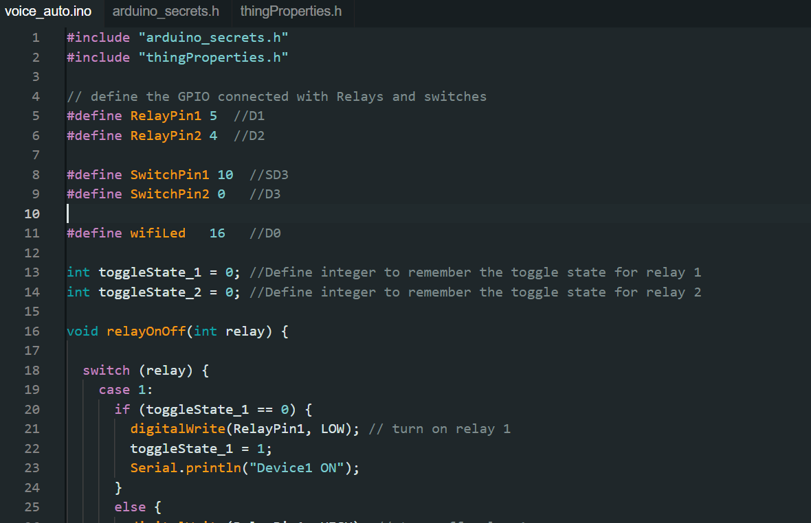


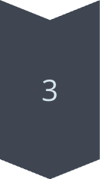
Code Deep Dive: Relay Control Logic
Key Function
The onSwitch1Change() function is crucial for controlling the relay. It reads the state of the light1 variable and sets the relay pin accordingly.
Relay Logic
void onSwitch1Change() {
digitalWrite(RelayPin1, light1 ? LOW : HIGH);
}
Explanation
If light1 is true (ON), the relay pin is set to LOW, activating the relay and turning on the appliance. If light1 is false (OFF), the relay pin is set to HIGH, deactivating the relay and turning off the appliance.

Slide 8




Demonstration and Key Advantages
Demo
Toggle the switch on the Arduino IoT Cloud dashboard to turn the bulb ON and OFF remotely. This showcases the real-time control capabilities of the system.
Low-Cost
1
Utilizing affordable components like NodeMCU and relay modules makes this a budget-friendly solution.
2
Scalable
4
Secure
Easily add more devices and expand your smart home automation system as needed.
3
The Arduino IoT Cloud provides secure communication between your device and the cloud.

Slide 9



Challenges and Future Possibilities
1
Voice control
2
Add sensors
3
Wi-Fi stability
Like any IoT project, this system can face challenges such as Wi-Fi connectivity issues. Implementing auto-reconnect code can help mitigate these problems. Looking ahead, we can integrate voice control via Alexa and incorporate sensors like PIR and temperature sensors for enhanced automation. These future additions can significantly improve the functionality and user experience of the system, making it a truly smart home solution.

Slide 10
Conclusion: Your Gateway to Advanced IoT Projects
1
Successfully built cloud-controlled system
2
Strong foundation for advanced projects
3
Explore possibilities
Congratulations! You have successfully built a cloud-controlled automation system that serves as a foundation for advanced IoT projects. This project opens the door to numerous possibilities in smart home automation and beyond. Feel free to explore new sensors, functionalities, and integrations to create a truly personalized and intelligent environment. The world of IoT is vast, and your journey has just begun!

